Slide 1
fMRI Quality Assessment Report
Generated on 2025-10-13 15:09:01
3 datasets analyzed

Slide 2
QA Summary
Dataset Summary:
1. sub001-visit001_3315-101_Sweet_02092025_2025090215...
• TR: 1.4s | Ernst: 0.816
• 4 QA images | Shape: 128×128×57
2. sub001-visit001_3315-101_Sweet_02092025_2025090215...
• TR: 2.0s | Ernst: 1.000
• 4 QA images | Shape: 128×128×76
3. sub001-visit001_3315-101_Sweet_02092025_2025090215...
• TR: 2.2s | Ernst: 1.000
• 4 QA images | Shape: 256×256×76

Slide 3
Dataset 1: sub001-visit001_3315-101_Sweet_02092025_20250902150849_4_fmri_MB3_ARC2_fMRI_2mm
File: sub001-visit001_3315-101_Sweet_02092025_20250902150849_4_fmri_MB3_ARC2_fMRI_2mm
QA Metrics Summary: • TR (Repetition Time): 1.4s • Ernst scaling factor: 0.8155 • Image data shape: 128 × 128 × 57 × 200 voxels Technical Details: • QA output directory: qa_output_sub001-visit001_3315-101_Sweet_02092025_20250902150849_4_fmri_MB3_ARC2_fMRI_2mm • Generated QA images: 4 files Key QA Images: • isnr_montage.png • mean_montage.png • tsnr_montage.png

Slide 4
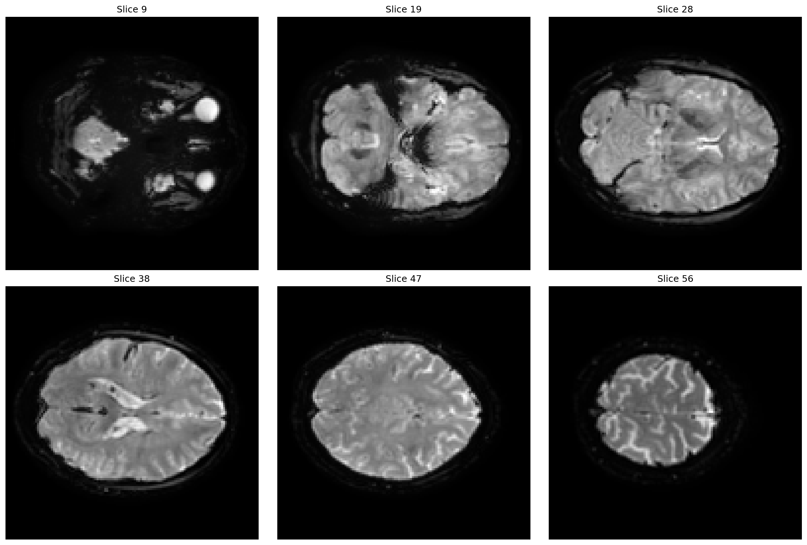
Dataset 1: Mean Images
Mean Montage

Slide 5
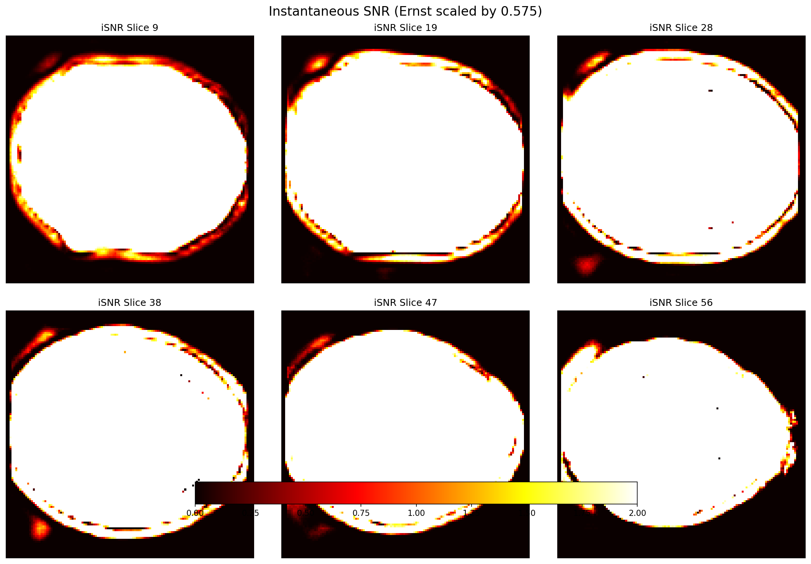
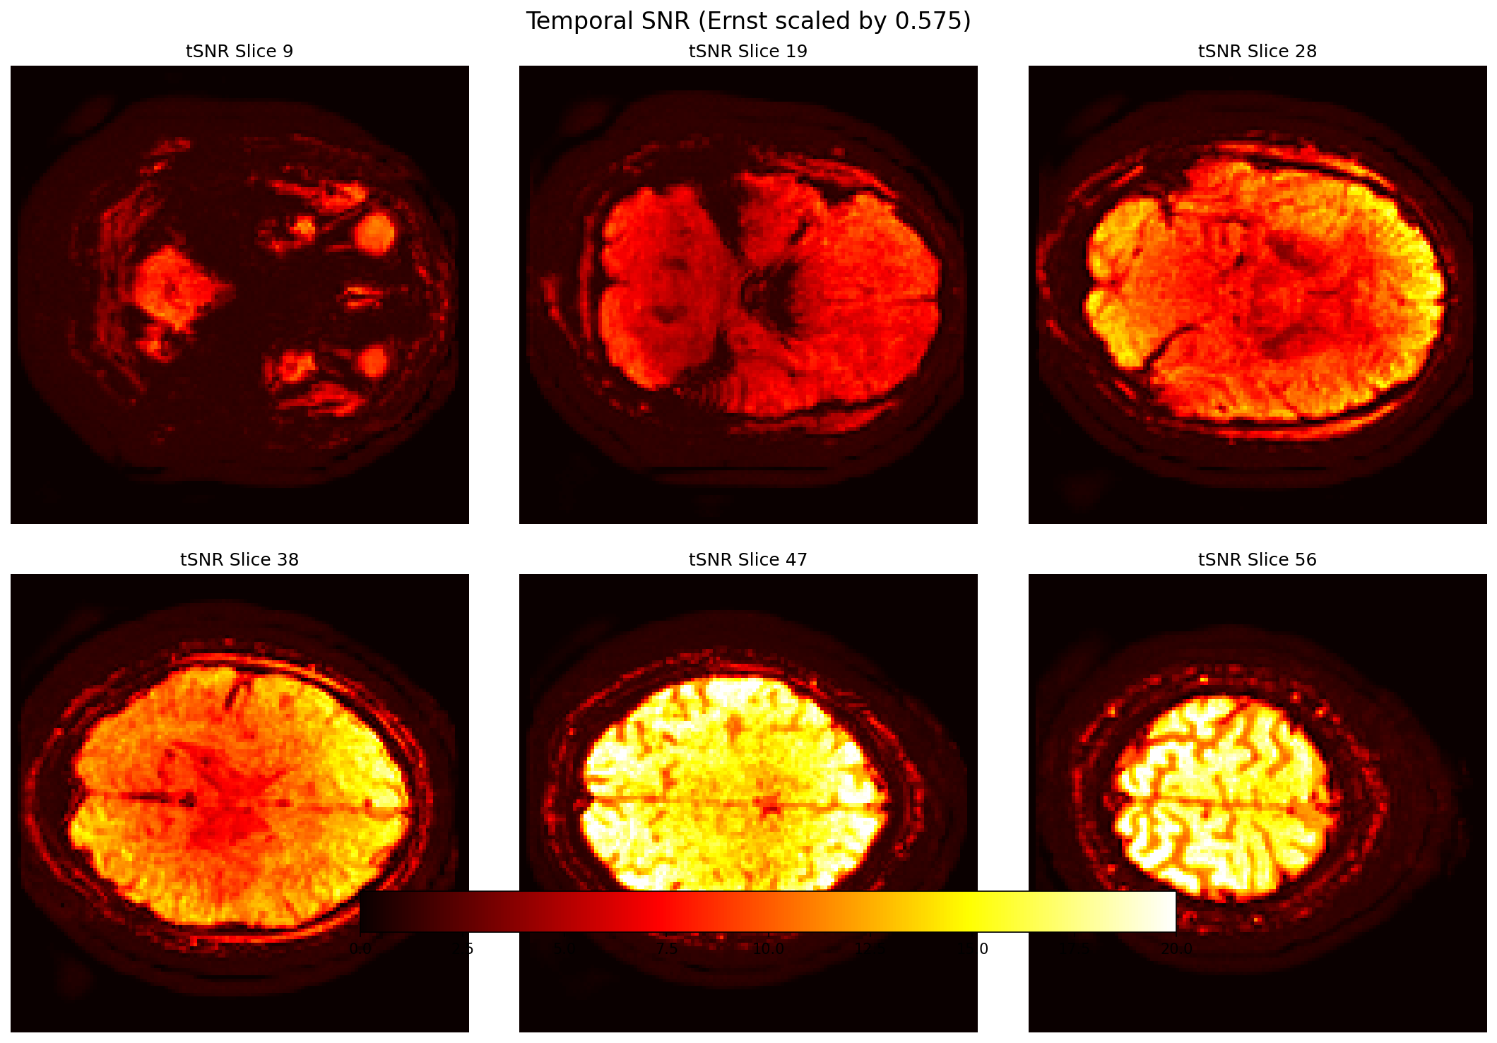
Dataset 1: SNR Analysis
Isnr Montage
Tsnr Montage

Slide 6
Dataset 1: Montage Views
Isnr Montage
Mean Montage
Tsnr Montage

Slide 7
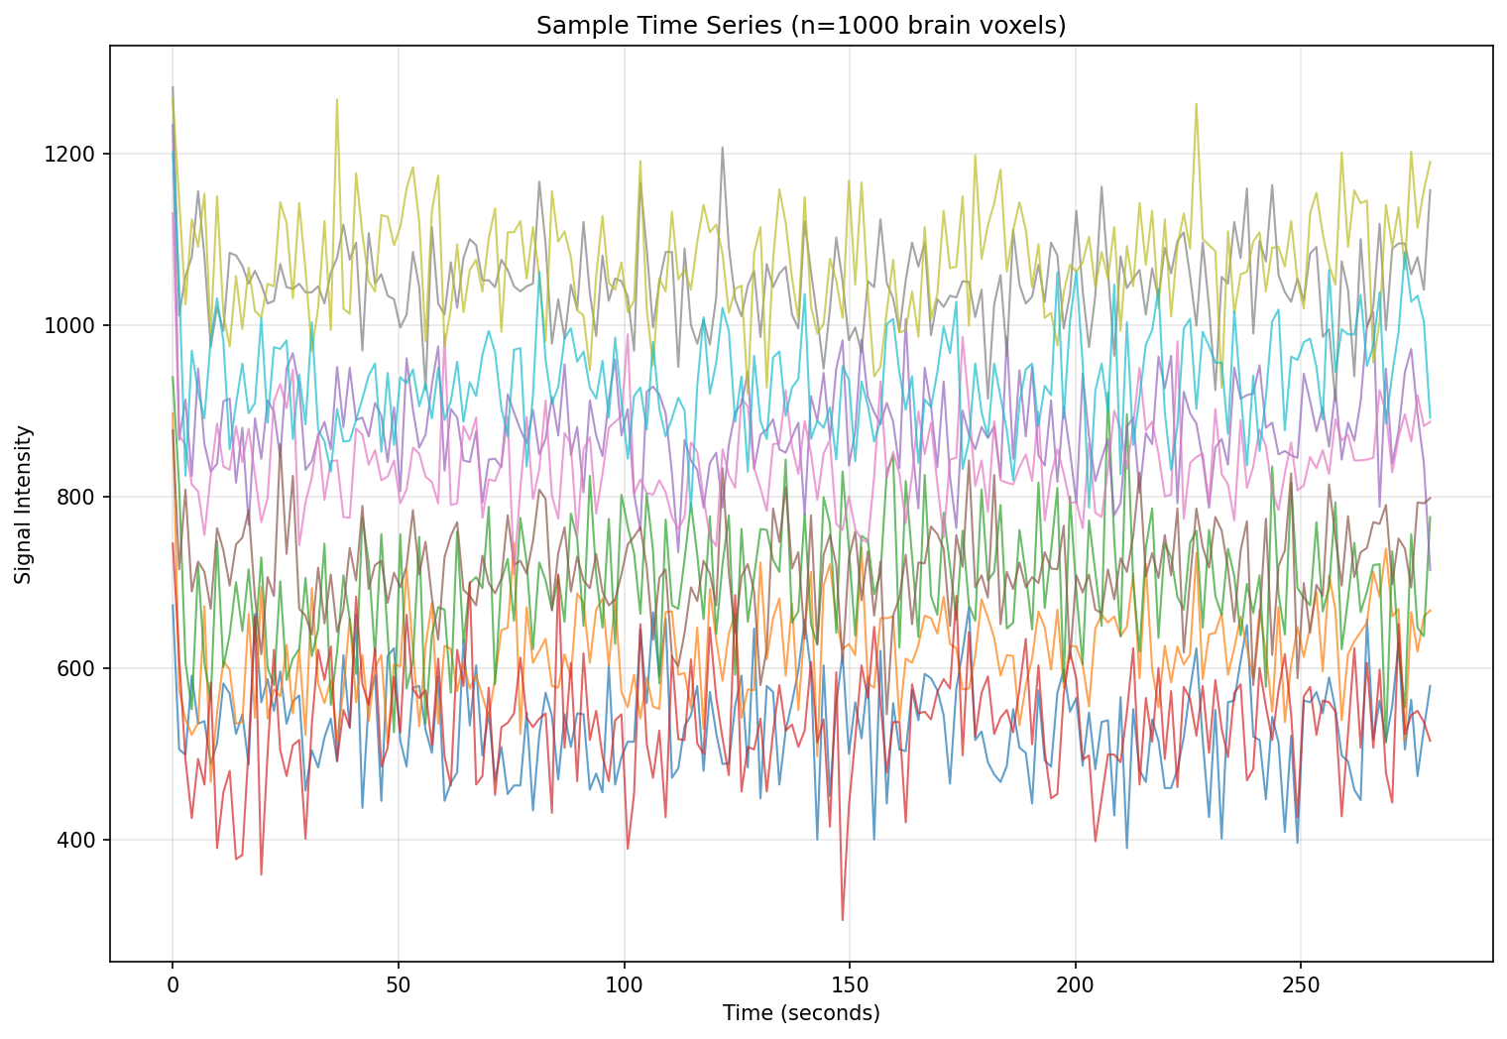
Dataset 1: Time Series
Sample Timeseries

Slide 8
Dataset 2: sub001-visit001_3315-101_Sweet_02092025_20250902150849_7_fmri_MB3_ARC2_fMRI_2mm_1.5
File: sub001-visit001_3315-101_Sweet_02092025_20250902150849_7_fmri_MB3_ARC2_fMRI_2mm_1.5
QA Metrics Summary: • TR (Repetition Time): 2.0s • Ernst scaling factor: 1.0000 • Image data shape: 128 × 128 × 76 × 200 voxels Technical Details: • QA output directory: qa_output_sub001-visit001_3315-101_Sweet_02092025_20250902150849_7_fmri_MB3_ARC2_fMRI_2mm_1.5 • Generated QA images: 4 files Key QA Images: • isnr_montage.png • mean_montage.png • tsnr_montage.png

Slide 9
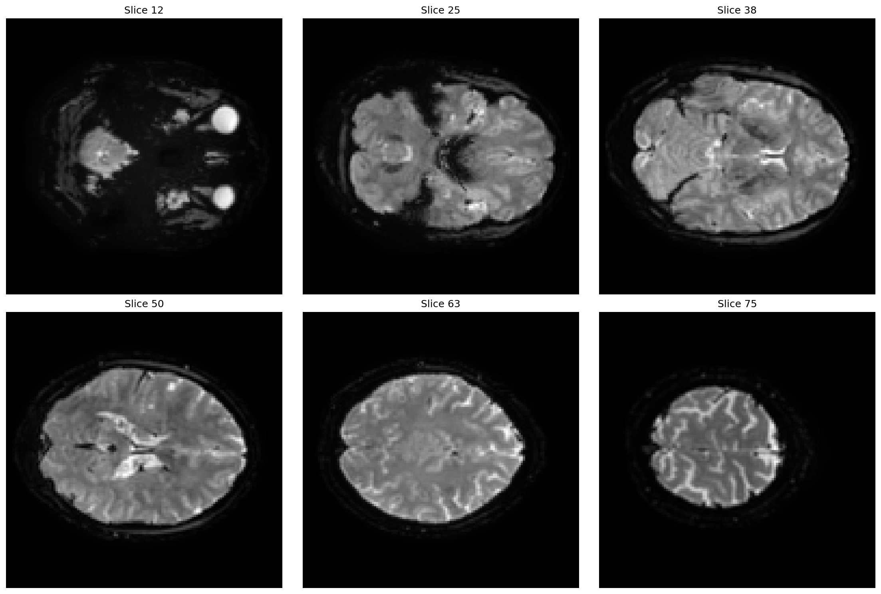
Dataset 2: Mean Images
Mean Montage

Slide 10
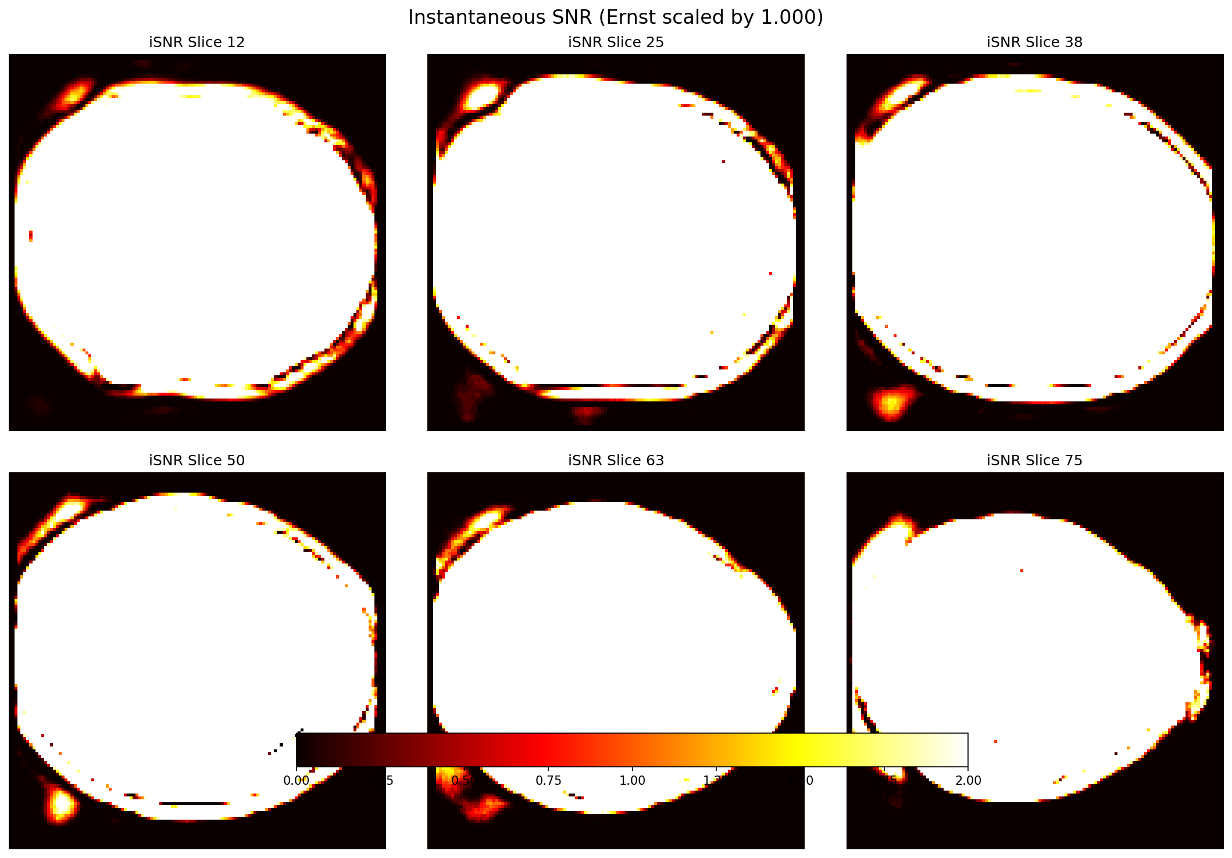
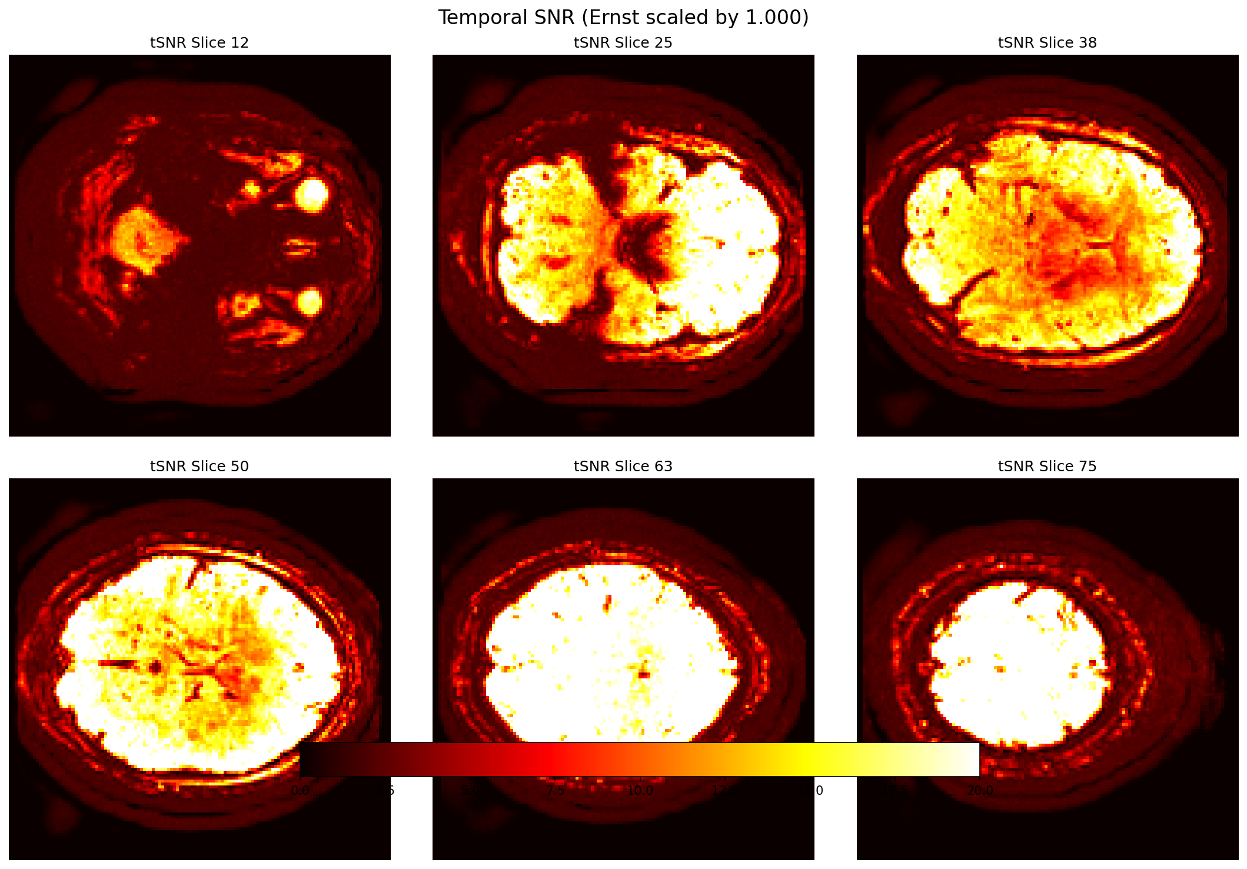
Dataset 2: SNR Analysis
Isnr Montage
Tsnr Montage

Slide 11
Dataset 2: Montage Views
Isnr Montage
Mean Montage
Tsnr Montage

Slide 12
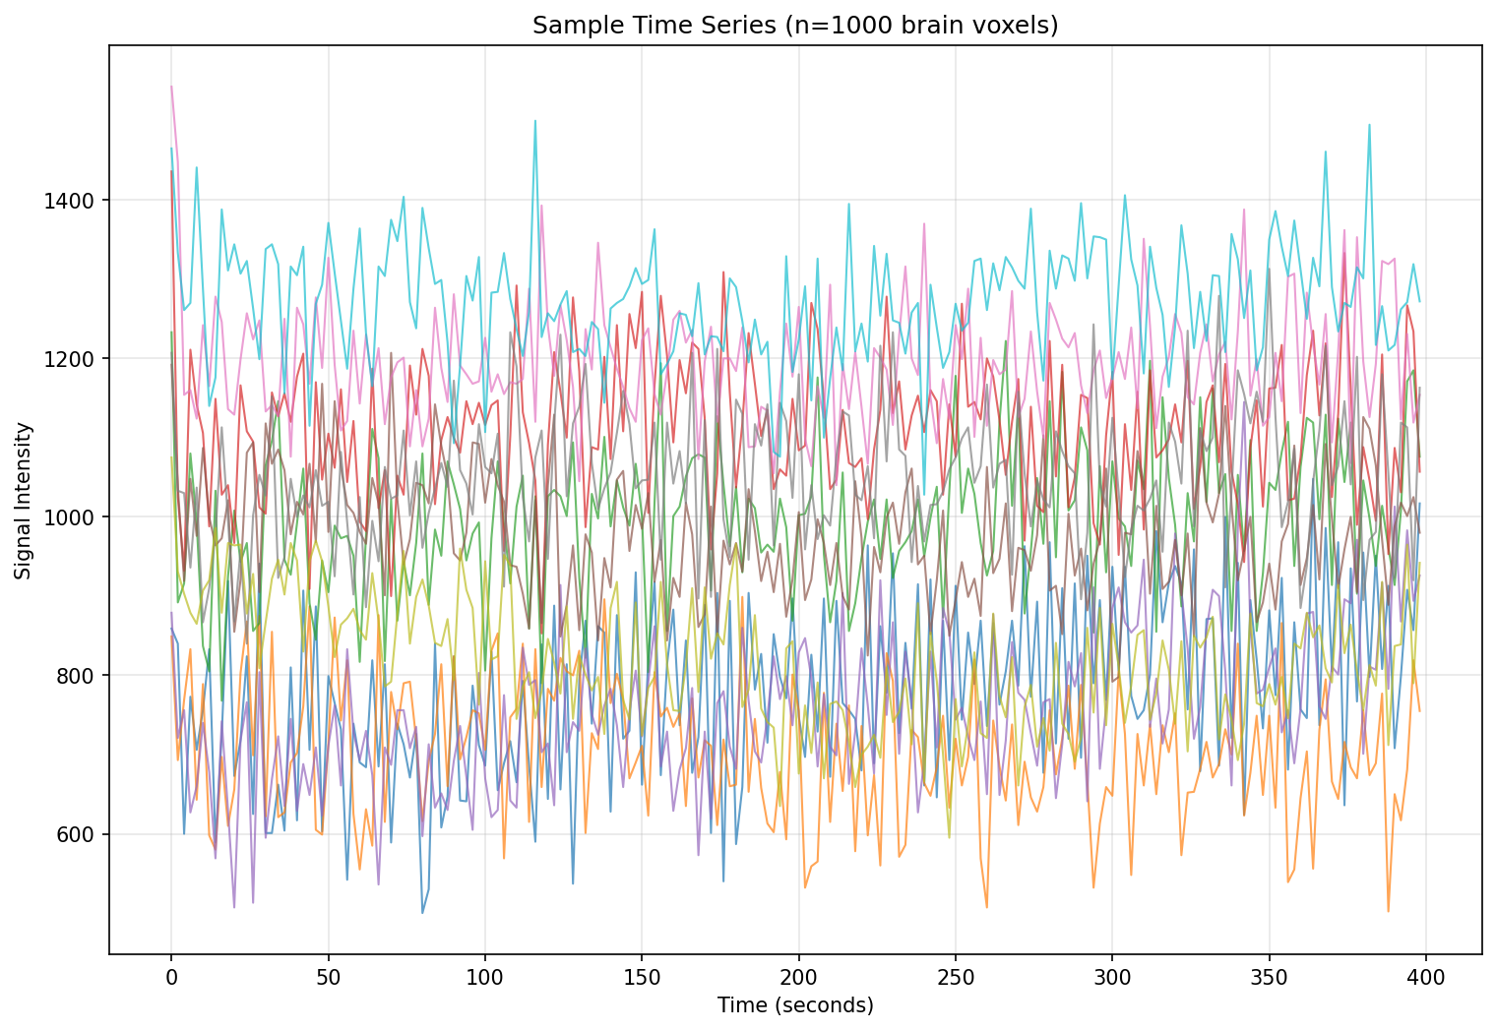
Dataset 2: Time Series
Sample Timeseries

Slide 13
Dataset 3: sub001-visit001_3315-101_Sweet_02092025_20250902150849_11_fmri_MB3_ARC2_fMRI_1.5_mm_iso
File: sub001-visit001_3315-101_Sweet_02092025_20250902150849_11_fmri_MB3_ARC2_fMRI_1.5_mm_iso
QA Metrics Summary: • TR (Repetition Time): 2.2s • Ernst scaling factor: 1.0000 • Image data shape: 256 × 256 × 76 × 200 voxels Technical Details: • QA output directory: qa_output_sub001-visit001_3315-101_Sweet_02092025_20250902150849_11_fmri_MB3_ARC2_fMRI_1.5_mm_iso • Generated QA images: 4 files Key QA Images: • isnr_montage.png • mean_montage.png • tsnr_montage.png

Slide 14
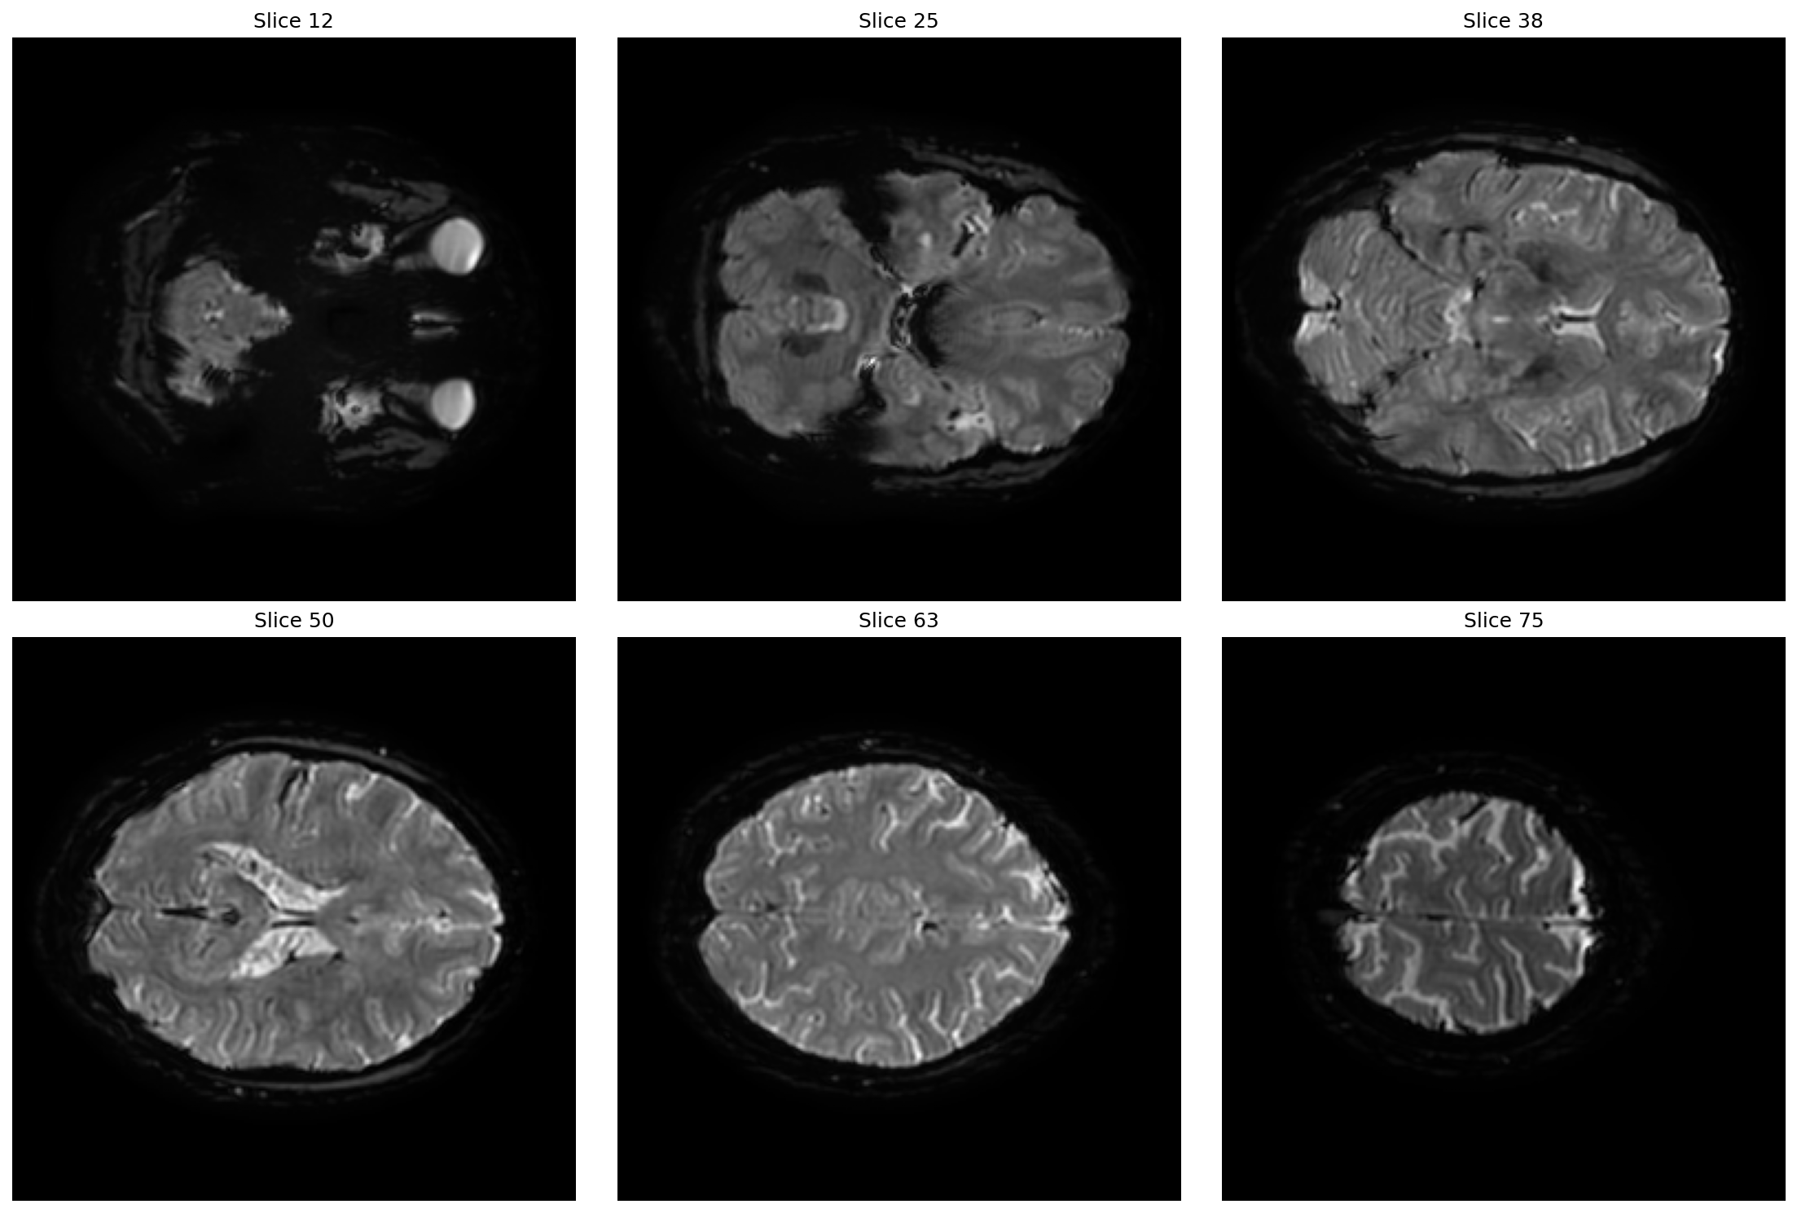
Dataset 3: Mean Images
Mean Montage

Slide 15
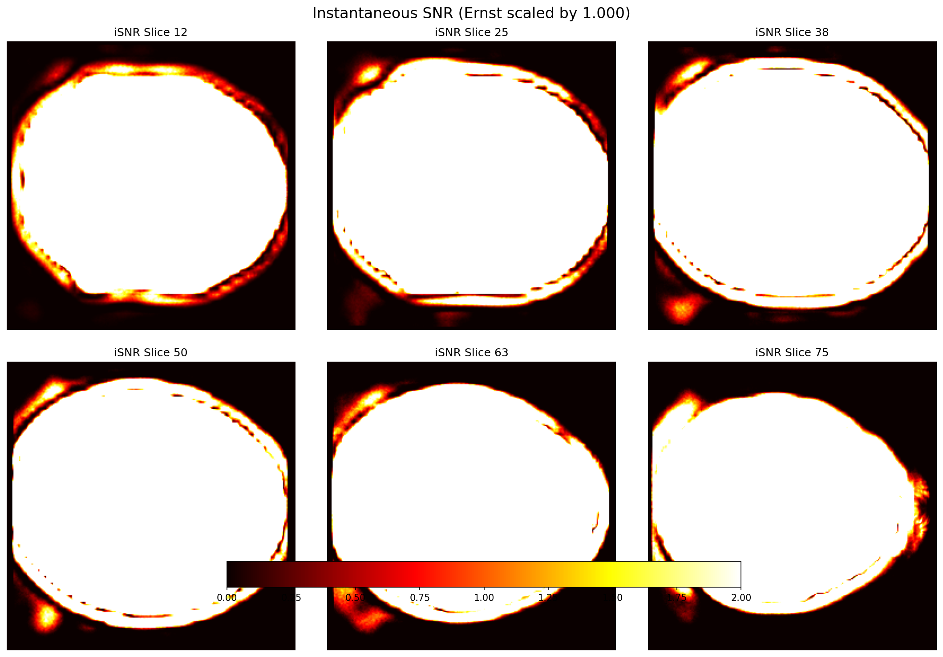
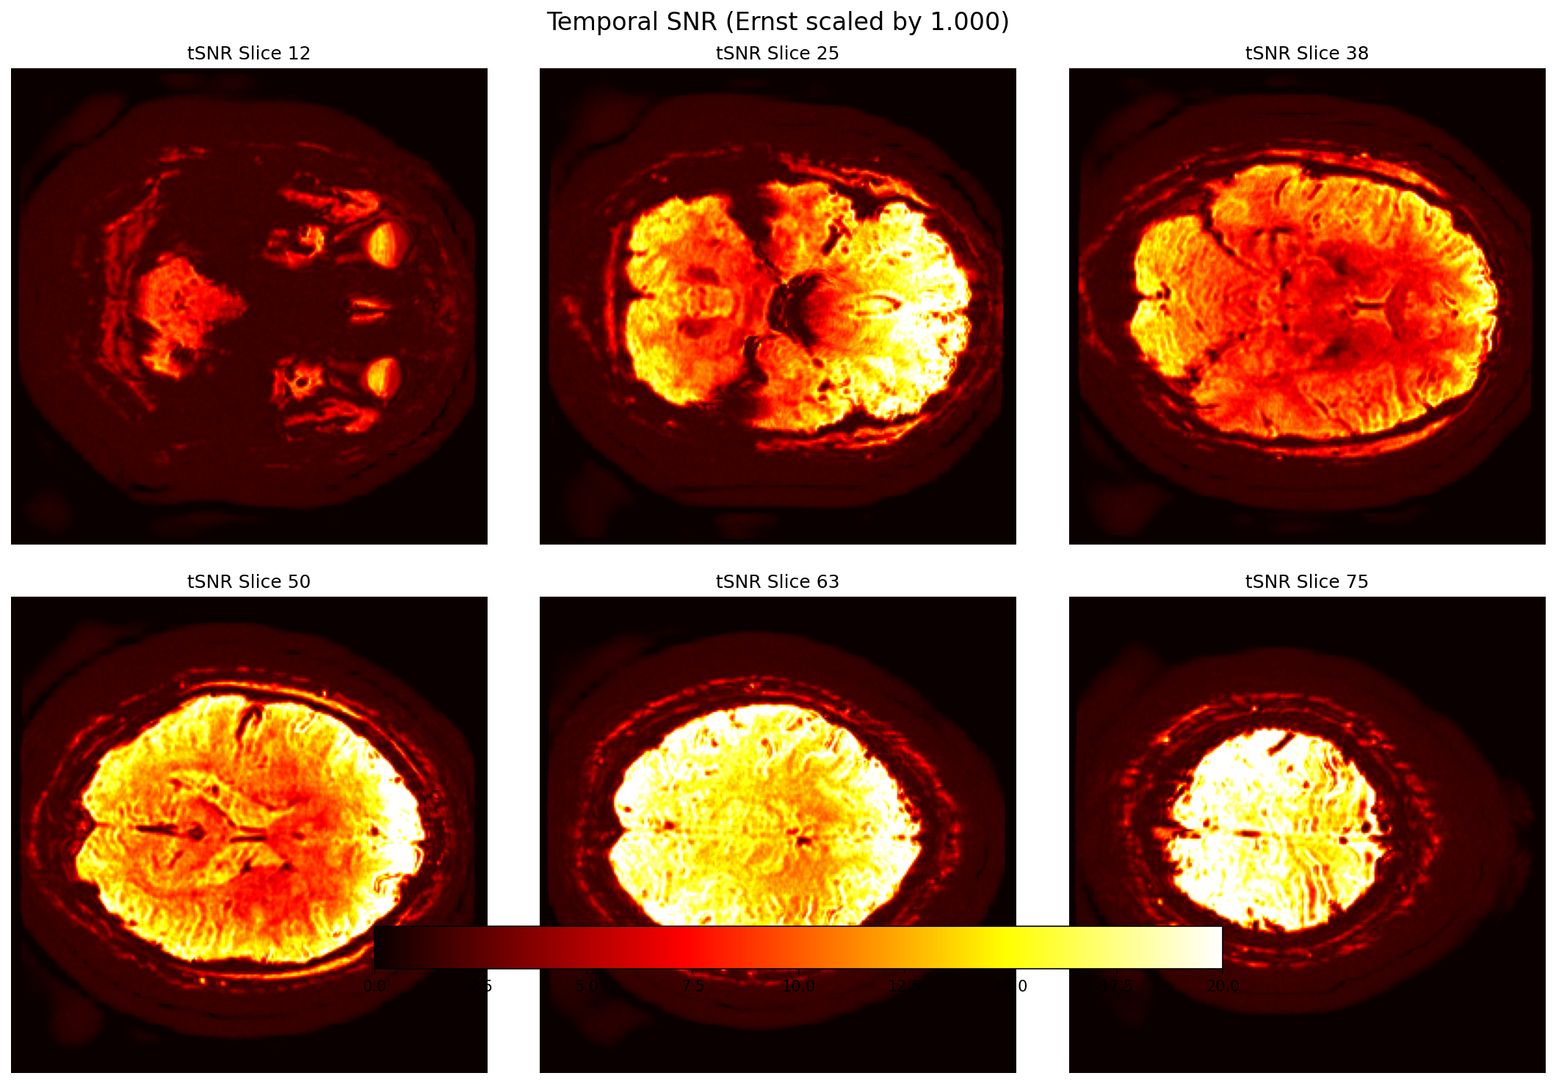
Dataset 3: SNR Analysis
Isnr Montage
Tsnr Montage

Slide 16
Dataset 3: Montage Views
Isnr Montage
Mean Montage
Tsnr Montage

Slide 17
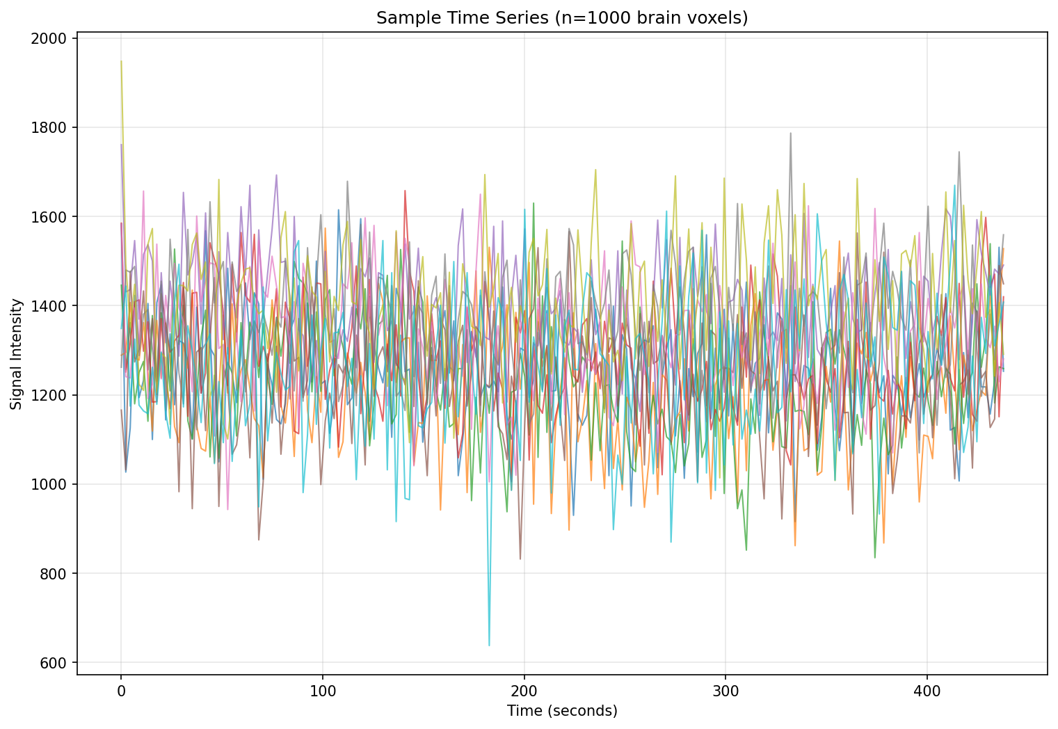
Dataset 3: Time Series
Sample Timeseries

